Slide 1
File Handling in Python
By Dr Shantanu Pathak

Slide 2
File Handling
Read / Write data to file
Basic file handling
Open
Close
Read
Write
Supported File format:
Based on text format
Binary Data
Advanced File Handling is performed using libraries like “pandas”

Slide 3
File Handling Functions
Open file : f=open()
Filename (/ → forward slash)
Mode
Encoding
Close file: f.close()
Limitations
With construct:
Safe closing of the file

Slide 4
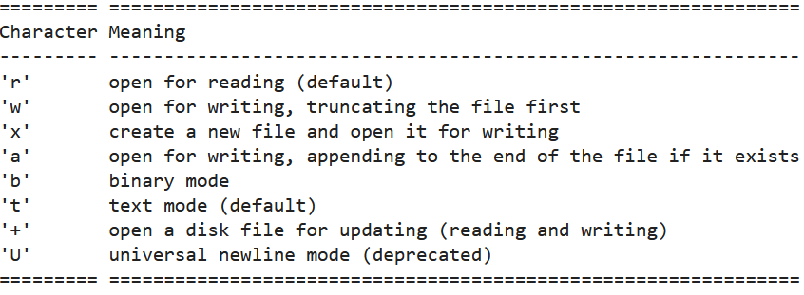
File Opening Mode

Slide 5
File Handling Functions
f.read(): read all contents of the file in single string
f.readlines() : read lines as a list of strings
Keeps “\n” at end of line which is used to understand an empty line
Directly use for loop to read the contents:
File can be read line by line in a for loop directly
Ex. for line in my_file:
print(line)
f.write() : passed string is put in the file
f.writelines(): passed list of strings is put to file
Doesn’t add “\n” at end of string
Programmer has to give the “\n” manually

Slide 6
Exercise
Read a file and count frequency of every word in the file
Read a csv file and split every line using “,”. Load all values from 3rd column in a list. Find the average of this column.

